Slide 1
What do we know about PrEP: from efficacy to effectiveness to impact
Jared Baeten MD PhD
Vice Chair, Department of Global Health
Professor, Departments of Global Health, Medicine, and Epidemiology
Director, UW/Fred Hutch Center for AIDS Research (CFAR)
Co-Director, International Clinical Research Center
Co-Principal Investigator, Microbicides Trials Network
University of Washington

Slide 2
Disclosures & Off-Label Use
I have received research funding for PrEP, microbicides, and related HIV prevention options from the Bill & Melinda Gates Foundation, CDC, NIH, PEPFAR, and USAID. For some research studies, medication has been donated by Gilead Sciences, the International Partnership for Microbicides, and other partners. I have served on an advisory board for Gilead Sciences.
FTC/TDF (Truvada®) PrEP, used daily, has a formal label indication in several countries. Other dosing strategies for combination FTC/TDF and other uses of antiretrovirals for HIV prevention have normative agency recommendations without formal label approval.

Slide 3
Acknowledgement
The results of PrEP research are a result of the volunteerism of tens of thousands of persons at risk for and living with HIV.

Slide 4
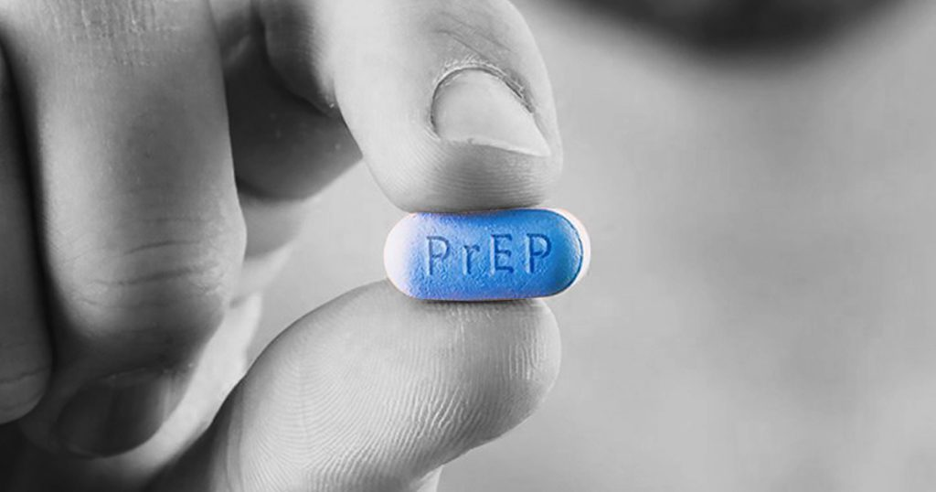
And then, there was PrEP…

Slide 5
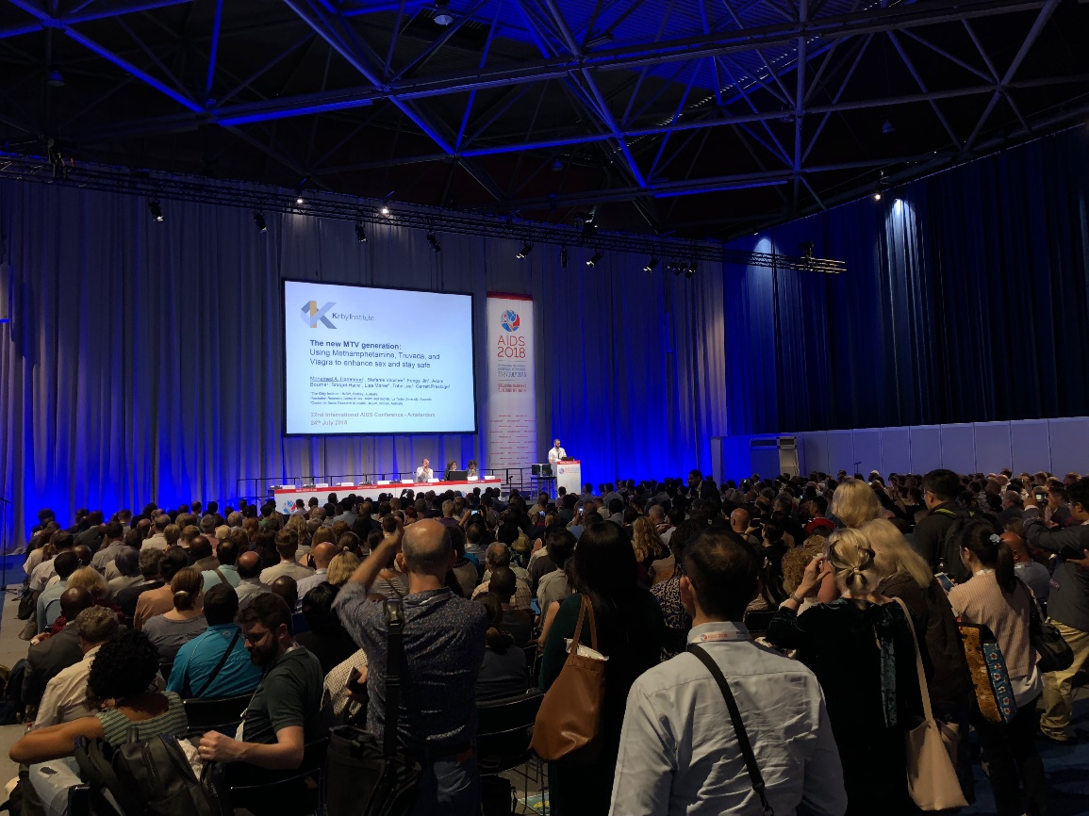
Now, PrEP is standing room only

Slide 6
What do we know about PrEP: from efficacy to effectiveness to impact
Clinical Trials
Open-Label Extensions & Demonstration Projects
Implementation and Scale-Up

Slide 7
What do we know about PrEP: from efficacy to effectiveness to impact
Clinical Trials
Open-Label Extensions & Demonstration Projects
Implementation and Scale-Up

Slide 8
Efficacy: Clinical Trials
>12 studies, across countries and continents
>20,000 participants
M/W/TGW; adults (adolescents); injection & sexual exposure

Slide 9
Efficacy: Clinical Trials
IPERGAY & PROUD
~100% adherence /
86% efficacy
Partners PrEP
81% adherence /
75% efficacy
TDF2
79% adherence /
62% efficacy
Bangkok
67% adherence /
49% efficacy
% population adherent
iPrEx
51% adherence /
44% efficacy
FEM-PrEP & VOICE
<30% adherence /
no efficacy
HIV protection efficacy

Slide 10
Efficacy: Near Complete Protection with High Adherence
 | HIV risk reduction
Partners PrEP any tenofovir | 90%
iPrEx / iPrEx OLE any tenofovir | 92%
iPrEx / iPrEx OLE ≥4 doses/wk *also on-demand PrEP in MSM | 100%
Baeten et al. NEJM 2012; Grant et al. NEJM 2010 & Lancet ID 2014; Molina et al. NEJM 2015

Slide 11
Efficacy: Safety
The bar for safety is very high for a preventative medication.
Trials demonstrated the safety of PrEP: well-tolerated,
without significant renal or other toxicity,
rare antiretroviral resistance

Slide 12
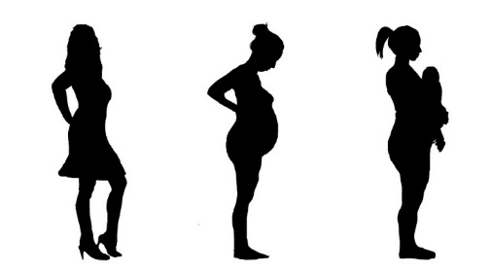
Efficacy: Reproductive Safety
Through an intentional series of studies, PrEP has has been found to appear safe across the reproductive life cycle:
Conception / Safer Conception
Pregnancy
Lactation
Contraception
Mugo et al. JAMA 2014
Matthews et al. JAIDS 2013
Murnane et al. AIDS 2014
Heffron et al. AIDS 2014
Were et al. AIDS 2014
Mugwanya et al. PLoS Med 2016
Mofenson et al. AIDS 2017
Heffron et al. AIDS 2018

Slide 13
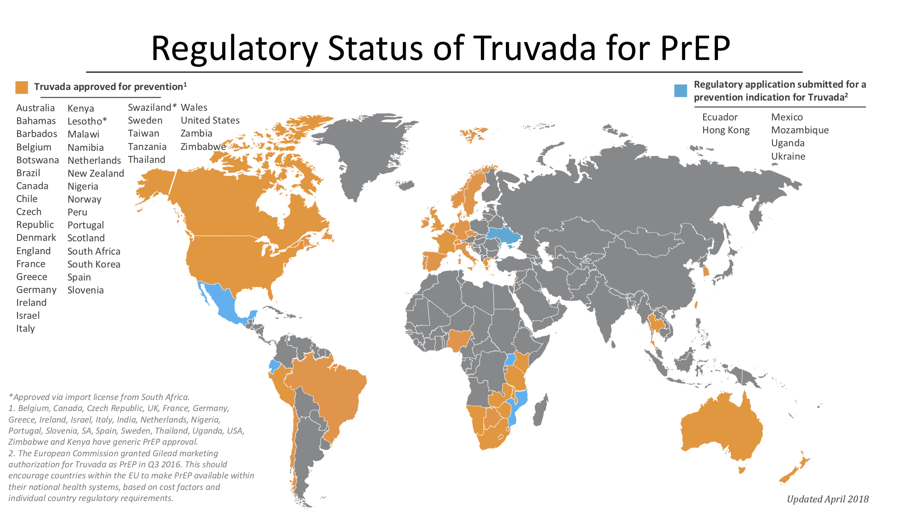
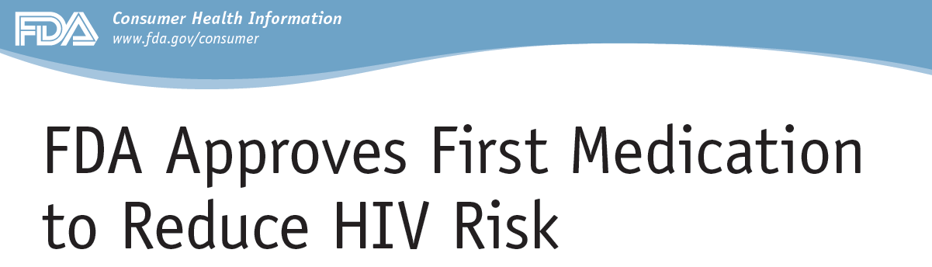
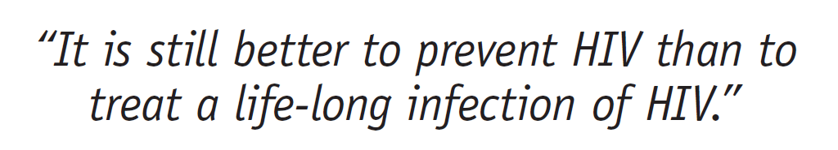
Efficacy: Regulatory Approval
Guidelines “..the use of daily oral pre-exposure prophylaxis is recommended as an additional prevention choice for people at substantial risk of HIV infection as part of combination prevention approaches..”
Deborah Birnkrant, director of the Division of Antiviral Products, US FDA, 16 July 2012

Slide 14
What do we know about PrEP: from efficacy to effectiveness to impact
PrEP works

Slide 15
What do we know about PrEP: from efficacy to effectiveness to impact
Clinical Trials
Open-Label Extensions & Demonstration Projects
Implementation and Scale-Up

Slide 16
Effectiveness > Efficacy
  In health, we expect that efficacy measured in clinical trials will be the best we can hope for, and that effectiveness in implementation settings will always be less.
  PrEP has been the opposite.
  .
Effectiveness | Efficacy
PROUD = 86% (nearly all adherent) | iPrEx = 44% (51% adherent)
Partners Demo = 95% (85% adherent) | Partners PrEP = 75% (81% adherent)
McCormack et al. Lancet 2016; Baeten et al. PLoS Med 2016

Slide 17
Effectiveness: Real-World
Kaiser-Permanente, CA, USA
N=657
12-month cumulative STI percentages
  STI rates were high, but no HIV occurred, in one large PrEP program from the US
  (Volk et al. Clin Infec Dis 2015)

Slide 18
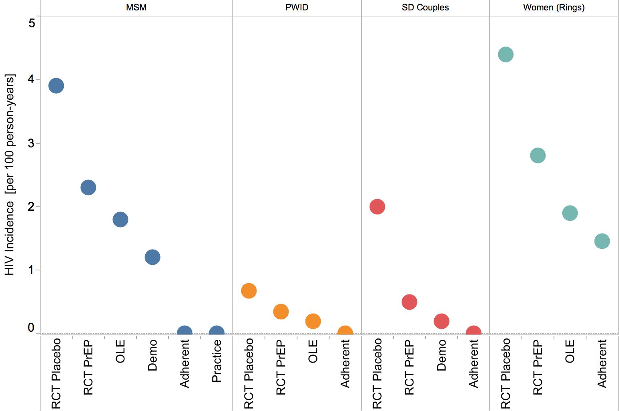
Effectiveness: HIV incidence

Slide 19
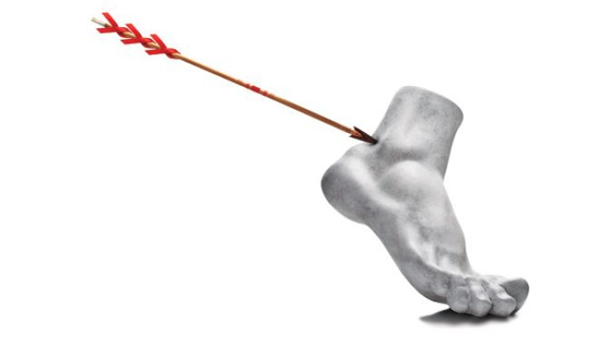
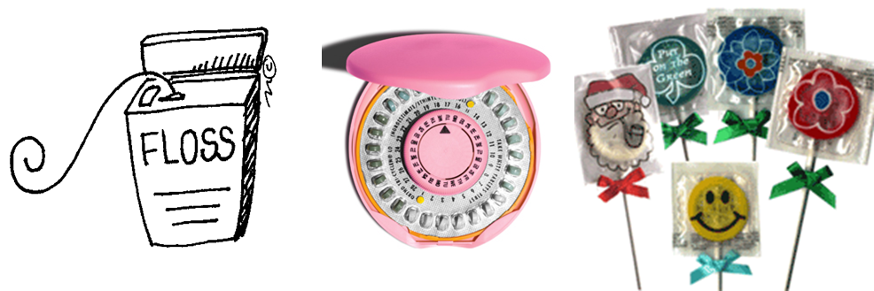
Effectiveness: Adherence
Liu et al. JAMA Intern Med 2016

Slide 20

Effectiveness: What PrEP Offers
What PrEP-takers say:
  Decreased anxiety, increased self-efficacy
  Increased communication, disclosure, trust
  Increased sexual pleasure & intimacy

Slide 21
What do we know about PrEP: from efficacy to effectiveness to impact
PrEP is workable

Slide 22
What do we know about PrEP: from efficacy to effectiveness to impact
Clinical Trials
Open-Label Extensions & Demonstration Projects
Implementation and Scale-Up

Slide 23
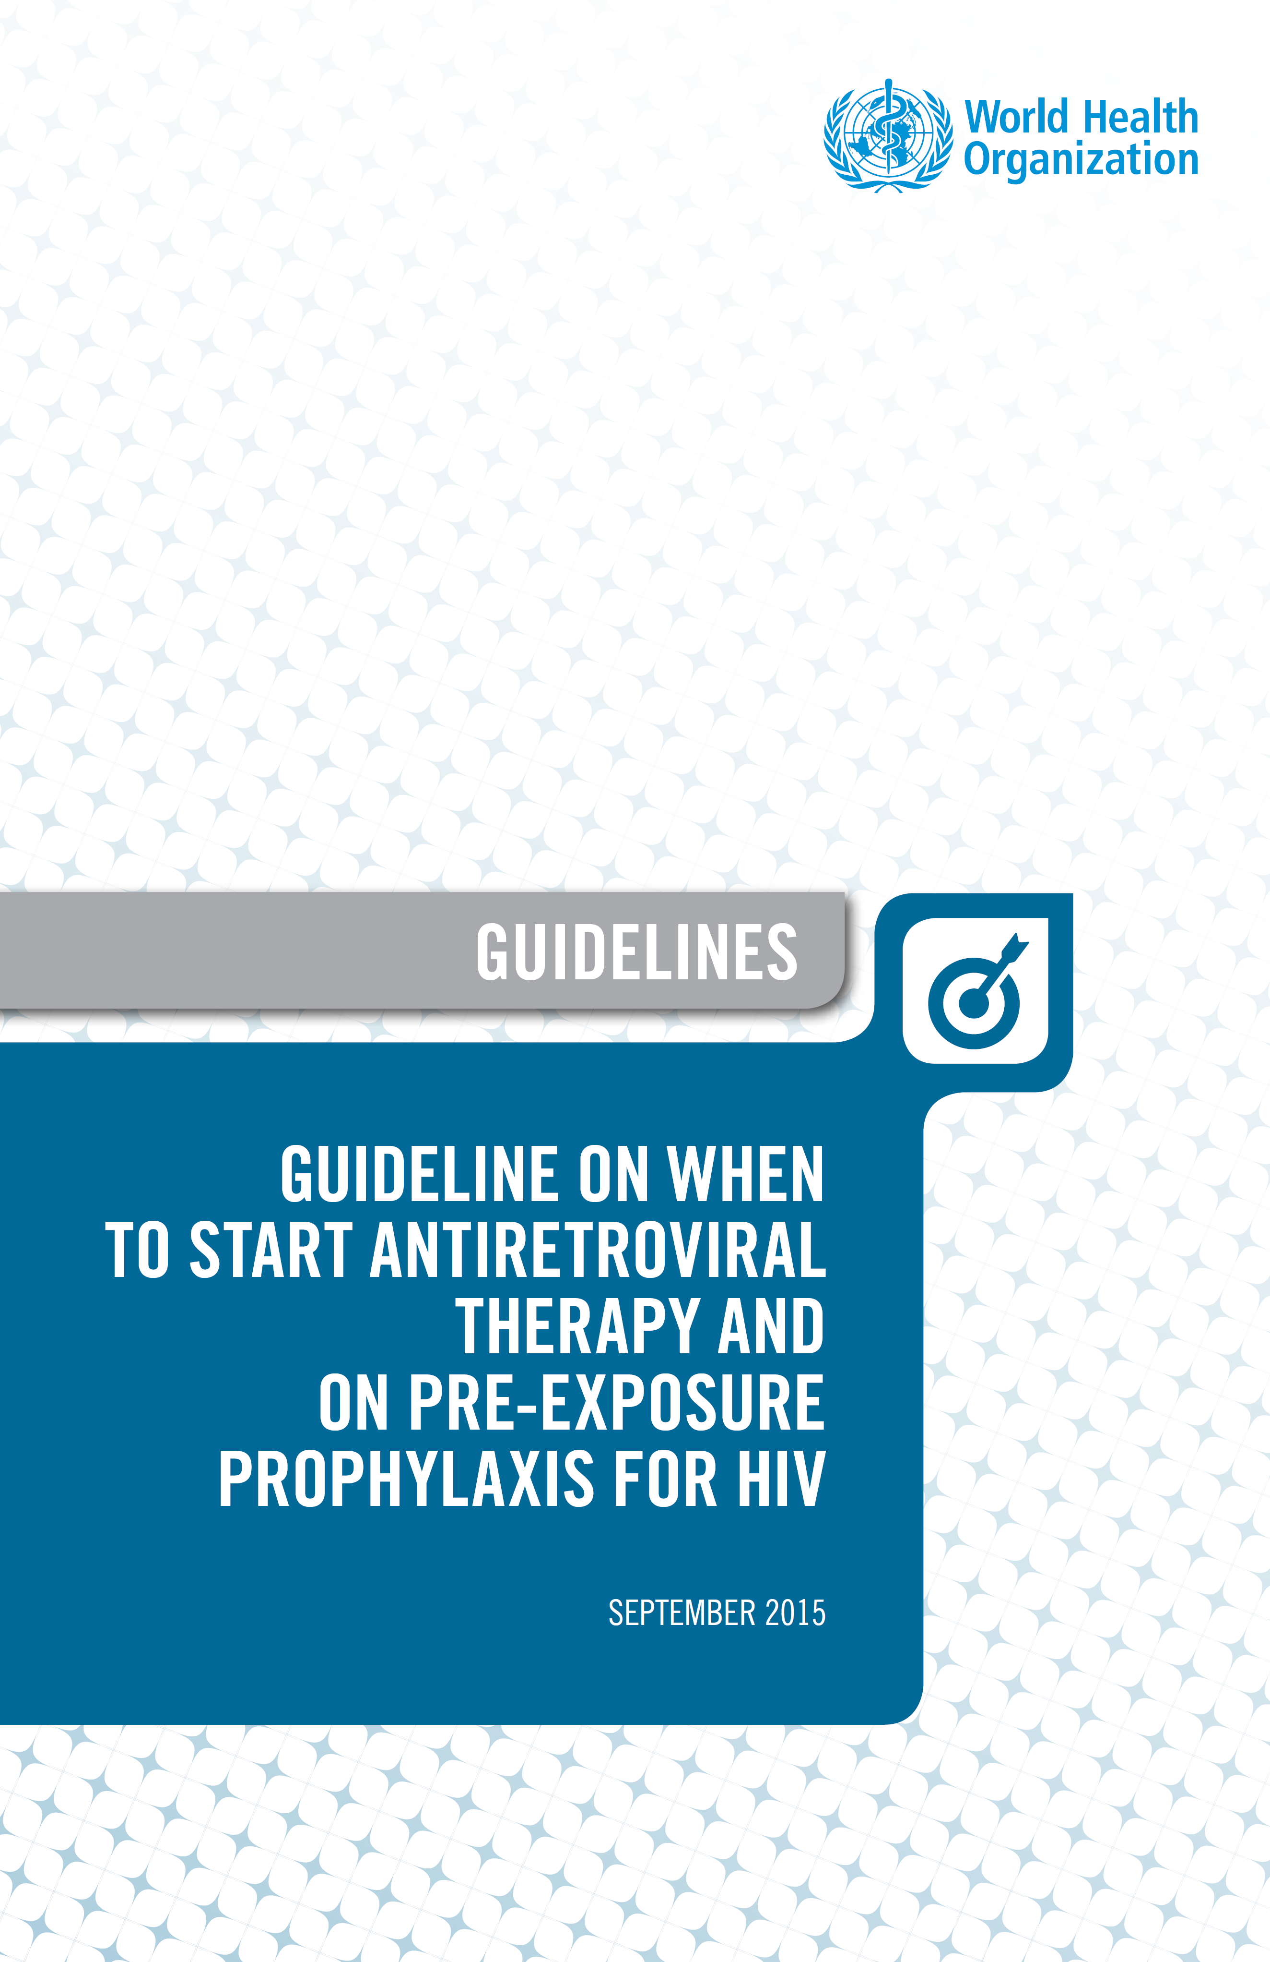
Impact: Normative Guidance
Guidelines “..the use of daily oral pre-exposure prophylaxis is recommended as an additional prevention choice for people at substantial risk of HIV infection as part of combination prevention approaches..”

Slide 24

Impact: Slow to Start
2013

Slide 25
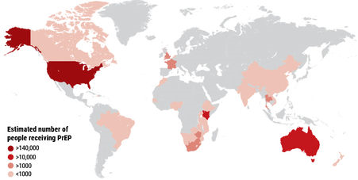
Impact: Growth
Global estimate ~300-350,000 cumulative to date
Cohen, Science, March 2018 & WHO

Slide 26
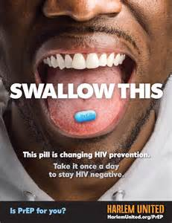
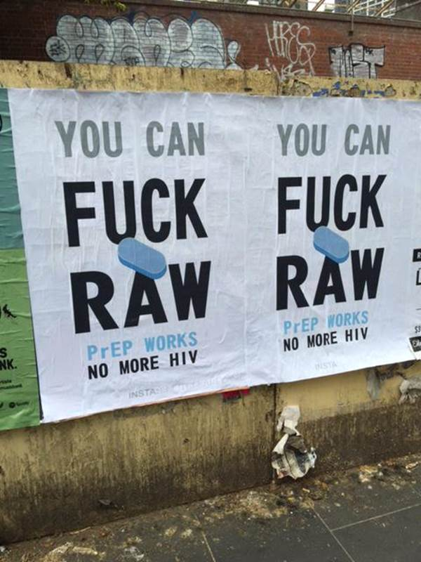
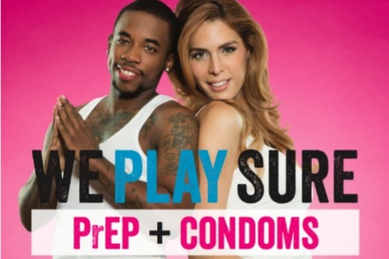
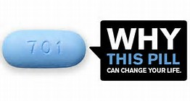
Impact: New Prevention Messaging

Slide 27
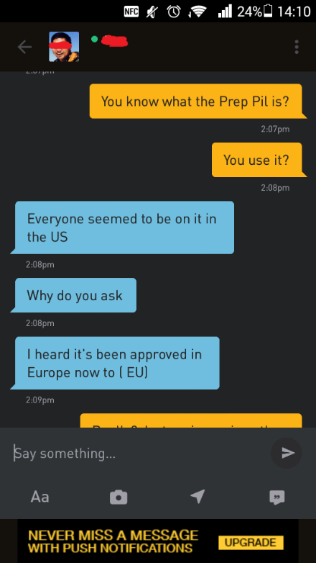

Impact: Normalization & Stigma
P=P

Slide 28
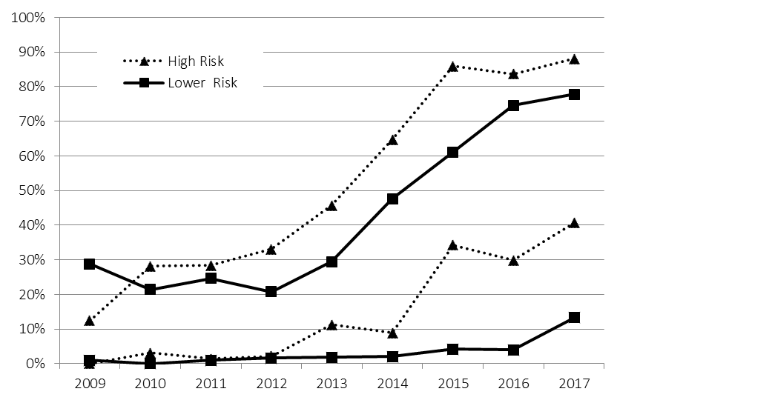
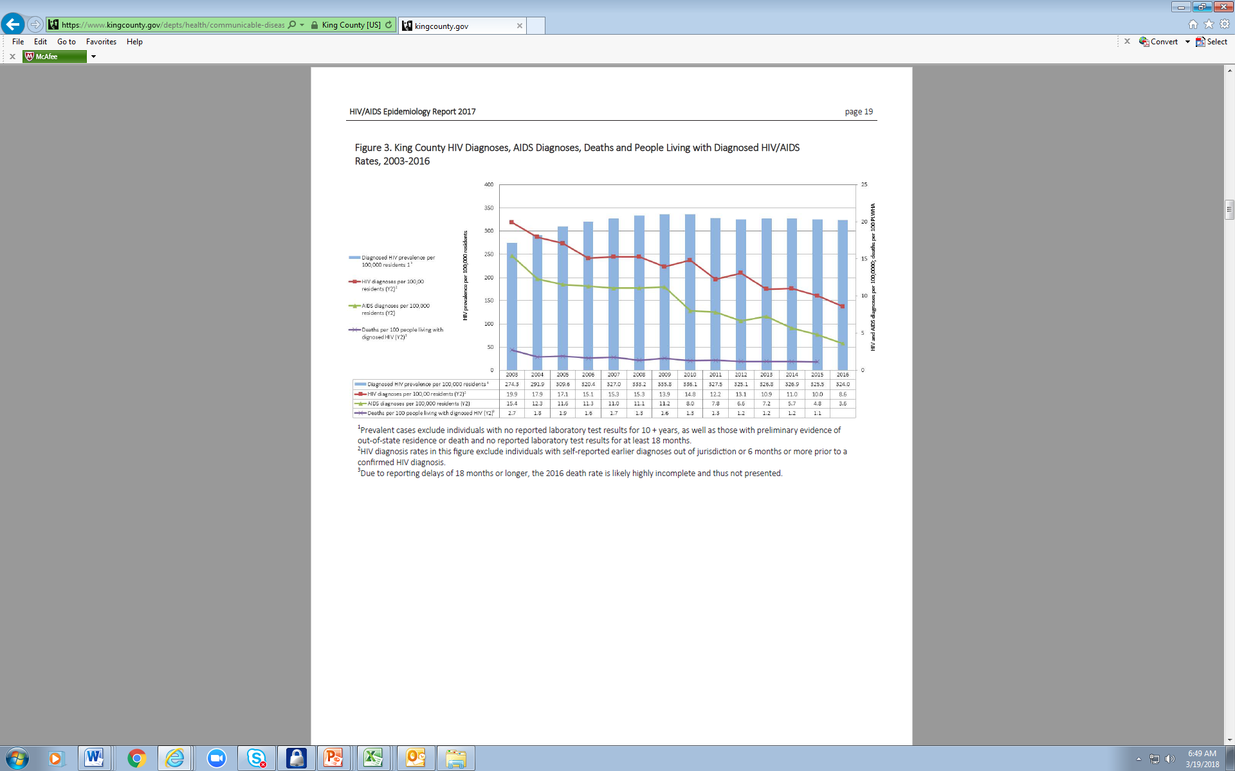
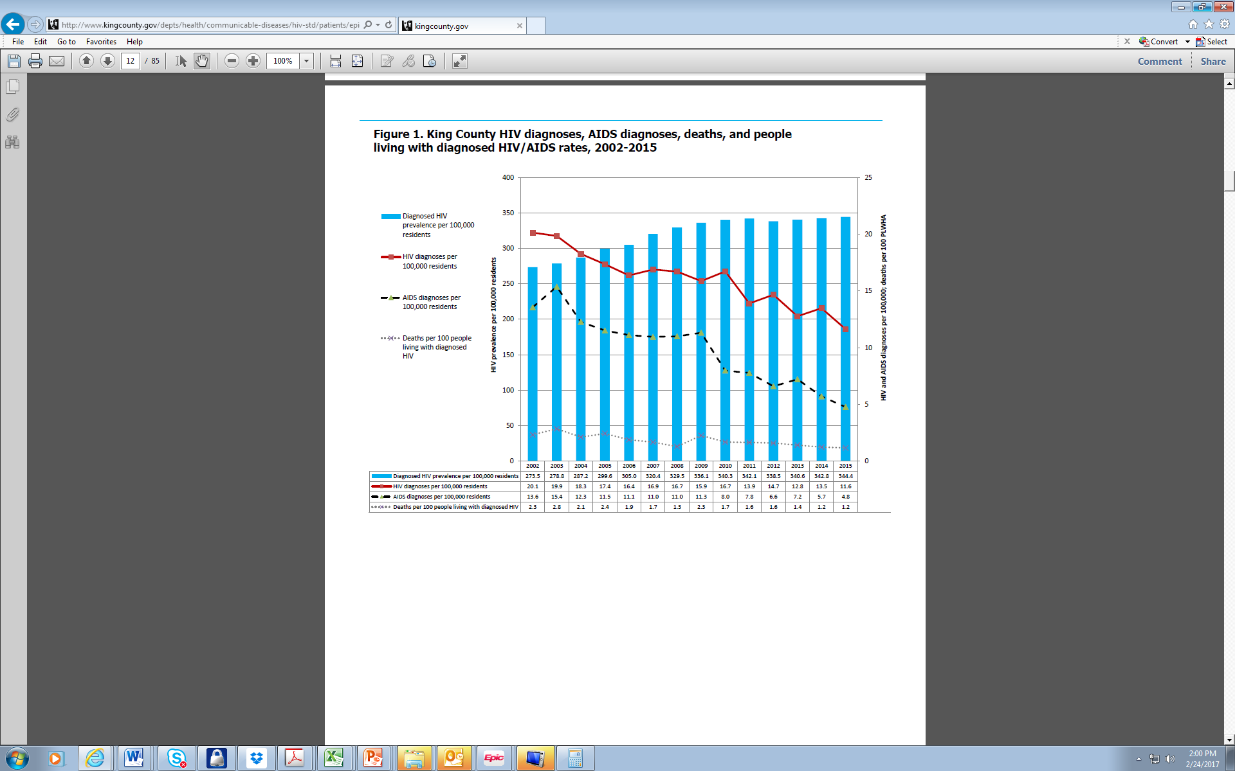
Impact: Seattle
Knowledge & Use of PrEP Among Seattle MSM Gay Pride Attendees, 2009-2017
New HIV diagnoses, prevalence, AIDS diagnoses, and deaths, Seattle
42% ↓
in new infections since 2010
Heard of PrEP
Ever Taken PrEP
Source: WA/KC 2017 HIV/AIDS Epidemiology Report & Matt Golden

Slide 29
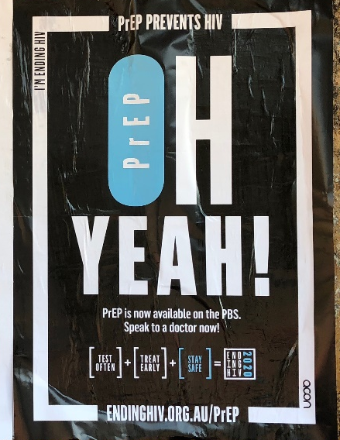
Impact: Big Cities
San Francisco 50+% reduction in new HIV infections in the past decade
Sydney 32% reduction with roll-out
London 42% reduction in 2016
SFDPH Annual Report 2017
Grulich et al. CROI 2018
Nwokolo et al. Lancet HIV 2017
All in context of high levels of testing & ART

Slide 30
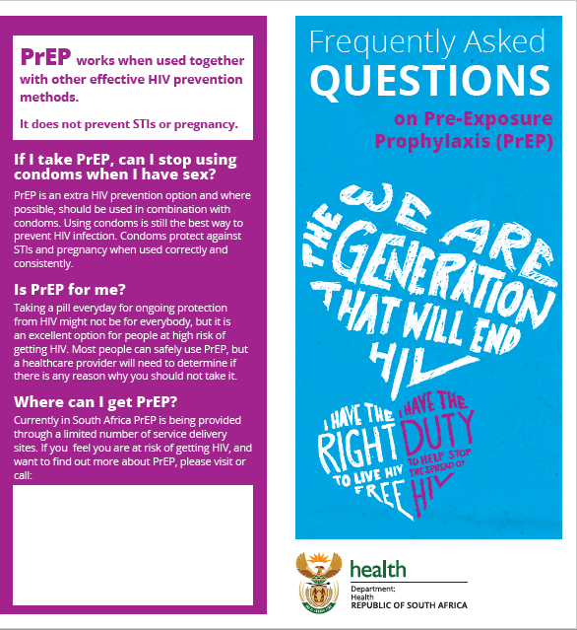

Impact: Programmatic Roll-Out

Slide 31
Impact: PrEP at AIDS 2018
What works:
  Easy access / differentiated care
    Easy to get, few labs, general population approach
  Delivery settings
    Integrated services, MCH & FP settings, youth-friendly, community-based, online, standard of care in prevention trials
  Dosing daily & on demand (for MSM)

Slide 32
What do we know about PrEP: from efficacy to effectiveness to impact
PrEP is working

Slide 33
What do we know about PrEP: from efficacy to effectiveness to impact
PrEP works
PrEP is workable
PrEP is working

Slide 34
What do we know about PrEP: from efficacy to effectiveness to impact
But it is not yet enough…

Slide 35
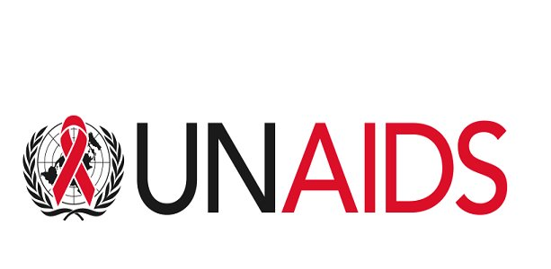
Not Enough: Goals

Slide 36

Not Enough: Expectations
Expectations of what is success for PrEP are still undefined:
  Uptake
  Adherence, retention
  Cost/cost-effectiveness (incidence)

Slide 37
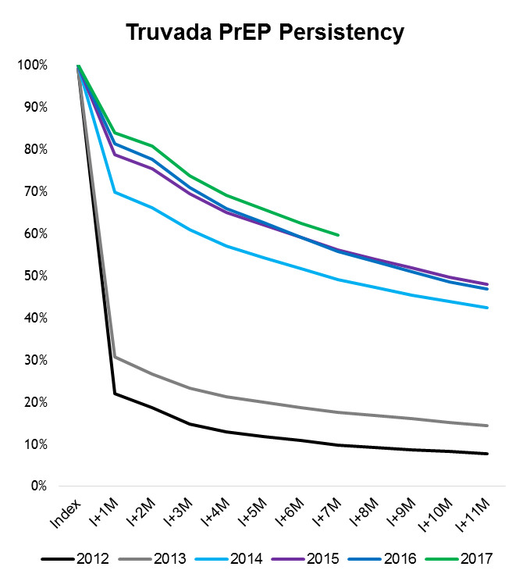
Not Enough: Continuation
In the US, PrEP continuation was initially poor.
Continuation has improved with time – as PrEP has normalized in communities.
% of Patients
Graphic = Gilead Sciences

Slide 38
Not Enough: Barriers
Stigma
HIV, risk, antiretrovirals
Access
policy, program, funding
Knowledge
marketing, community, normalization

Slide 39
Not Enough: Awareness

Slide 40
Not Enough: Complexity
PrEP is not treatment.
PrEP is primary prevention = analogous to contraception.
Easier strategies are necessary:
streamlined access, same-day start, integrated services, peer engagement, minimized laboratory testing, community delivery, etc.

Slide 41
Not Enough: STIs
GC
↑237%
Needed:
better diagnostics, active screening and treatment, access to STI medications, new strategies for preventing STIs
Reminder:
We are in the business of preventing disease, not preventing sex.
Seattle MSM STI diagnoses
CT
↑114%
Syphilis ↑195%
Diagnoses per 1000
HIV

Slide 42
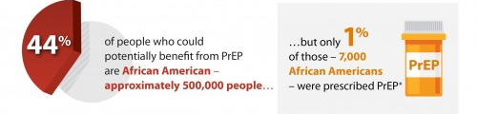
Not Enough: Disparities
US:
Source: CDC
Globally:

Slide 43
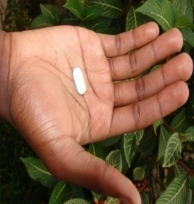

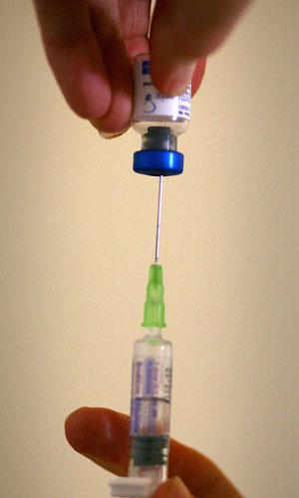
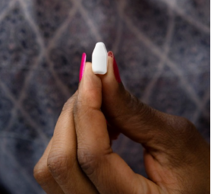
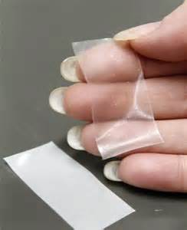
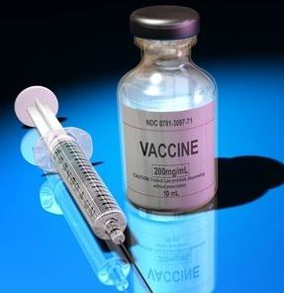



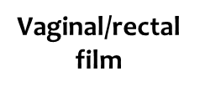
Not Enough: Choice
Vaginal/rectal inserts
BNAbs /
Vaccine
  For contraception, women regularly weigh side effects, efficacy, life burden, and “medicalization” when making choices.
People want options so they can make choices

Slide 44
Efficacy→Effectivness→Impact→Enough?

Slide 45
Parting thought…
What’s the most important progress we’ve made this decade in the HIV epidemic?
Treatment as prevention and preexposure prophylaxis, because if we really implement them properly, theoretically you could shut the epidemic off.
- Anthony Fauci, JAMA, July 2018

